Slide 1


Chiplet-Based Architectures for Scalable DNN Accelerators
Term Paper Presentation on
Presenters: Darpan Gaur (CO21BTECH11004)
Lakshya Arora (CS24RESCH11006)
Course Instructor: Dr. Rajesh Kedia

Slide 2
Slowing Down of Moore’s Law
Moore’s Law held true for several decades, but
slowing down due to both the physical and economic limitations:
Physical Limitations includes:
Transistors approaching the atomic scale (~3nm, 2nm nodes)
Quantum effects (like leakage and tunnelling) makes scaling difficult
Heat dissipation issues as more transistors packed into the same area
Economic Limitation includes:
Chip manufacturing costs are skyrocketing
Fabs (semiconductor manufacturing plants) cost billions (e.g., TSMC’s latest fab costs ~$20 billion)
As a result, transistor scaling is no longer the best path to improve performance.

Slide 3
Post-Moore’s Era: What’s Next ?
Since, Traditional Monolithic scaling is slowing down, the semiconductor industry is shifting towards alternative methods including:
Multi-Chip Modules (MCMs) & Chiplets : Instead of making one big monolithic chip, multiple smaller chiplets are connected in a single package. Example: AMD’s Ryzen CPUs, NVIDIA’s Hopper GPUs, Intel’s Meteor Lake.
3D Stacking & Advanced Packaging: Memory-on-Logic stacking using TSMC’s CoWoS, Intel’s Foveros. High Bandwidth Memory (HBM) for AI workloads.
Specialized Accelerators (AI & ML) such as Google’s TPU, NVIDIA’s Tensor Cores, and Graphcore’s AI chips optimize deep learning workloads.
Alternative Computing Paradigms like Quantum Computing, Neuromorphic Computing, Photonic Chips being explored.

Slide 4
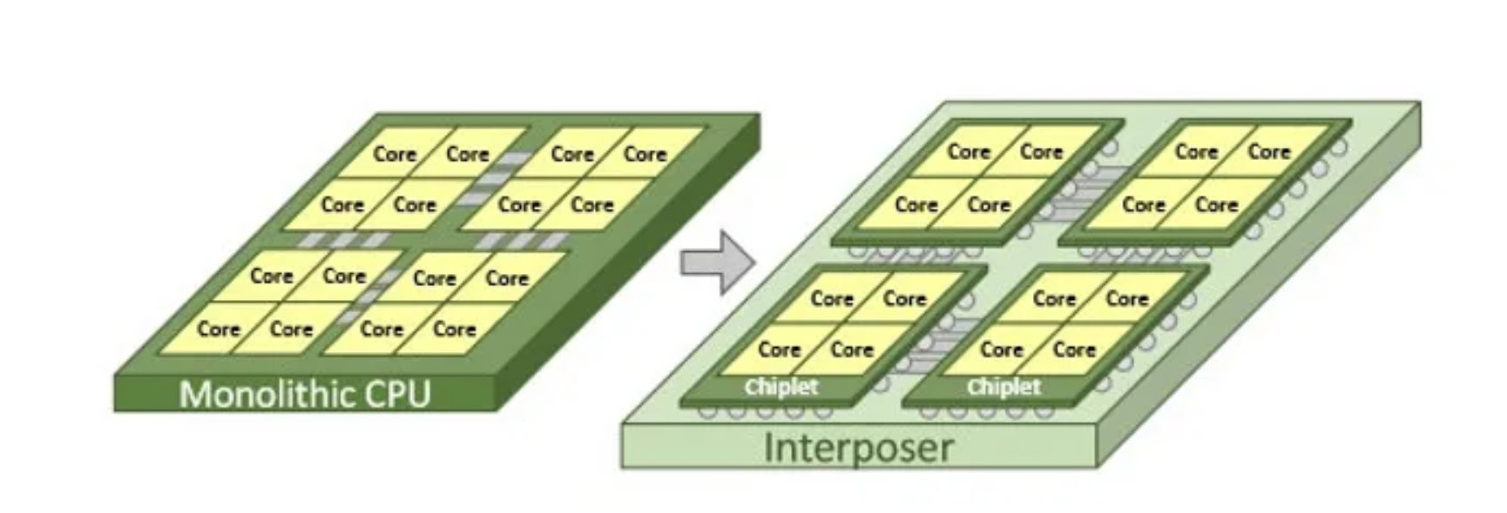
Transition from Large Monolithic Chip to Smaller Chiplets Architecture
Chiplet-Based Architectures
What is Chiplet technology?
As a baseline, the traditional monolithic chip architecture consists of off functions/cores of a circuit integrated onto a single silicon die.
A Chiplet, in contrast, disaggregates all functions into modular interoperable units. Each of these may be optimized for a specific function and “mixed and matched” together to create a comprehensive system.
In the other word, the Chiplet-design architecture is like playing Legos!
https://medium.com/@heng.huang/why-we-invested-in-silicon-box-and-advanced-chiplet-packaging-3d1905c6ec2e

Slide 5
Why Chiplet-Based Architectures ?
Lower Manufacturing Cost
Higher Yield
Lower Fabrication cost
Increased Design Flexibility
Scalability and Customization
Reduced Power Consumption
High Performance Computing
High Reliability

Slide 6
Multi-Chip-Module Packaging
Slowing transistors scaling
Reducing cost
– Yield losses cause fabrication cost to grow super linearly with die size
MCM Packaging
– Assembling large-scale systems using small building blocks known as chiplets
– Multiple chiplets connected via on-package links
using a silicon interposer

Slide 7
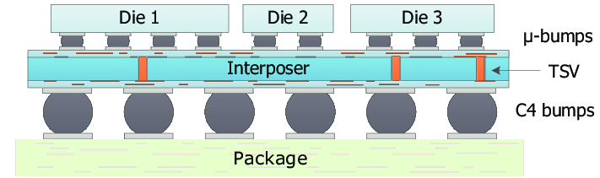
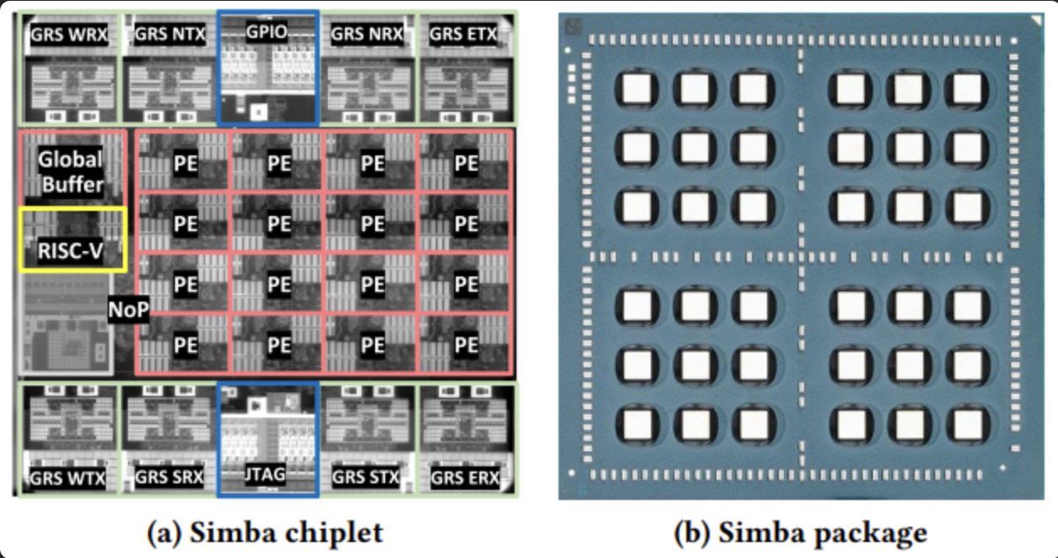
Package Level Integration
Multiple Chiplets on a Single Package connected together through a Network-on-Interposer (NoI)
Further, each chiplet has several Processing Elements (PE’s) for computation
https://hackmd.io/@nctu-cas-lab/rJTovb6td

Slide 8
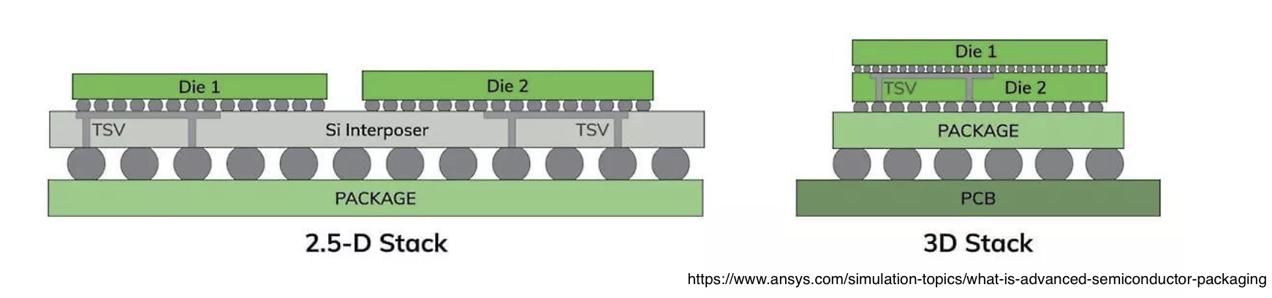
Die-stacking
Combination of multiple distinct silicon chips
within a single package (Packaging Technologies)
– Vertical or 3D stacking
– 2.5D stacking

Slide 9
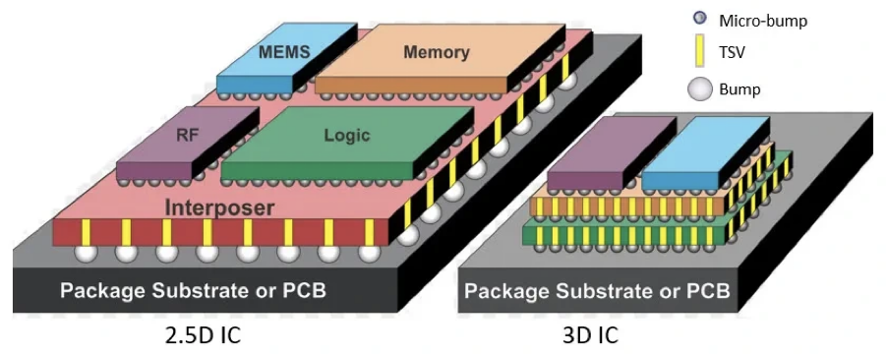
Interposer
A silicon or organic substrate with routing capabilities
Intermediate electrical layer between a chip or chiplets and a circuit board
Used for routing signals and power
https://techovedas.com/what-is-2d-2-5d-3d-packaging-of-integrated-chips/

Slide 10
Chiplet-based architectures for various applications:
1. DNN Acceleration: CHIPLET-BASED TRAINING ACCELERATORS
2. General Purpose SoCs / Modular Architectures: Intel’s Foveros & Lakefield, AMD’s Infinity Fabric , Chiplet-based RISC-V Systems
3. Recommendation Systems: Centaur (ISCA 2020), RecNMP (HPCA 2021)
4. Data Center & Heterogeneous Architectures: Cerberus (MICRO 2020) , The Modular Accelerator Fabric (MAF , POSEIDON (MICRO 2021)
5. Memory-Centric Architectures: Near-Memory Processing (NMP) Chiplets, HBM-PIM , TeraPHY + BoW (Bunch of Wires)

Slide 11
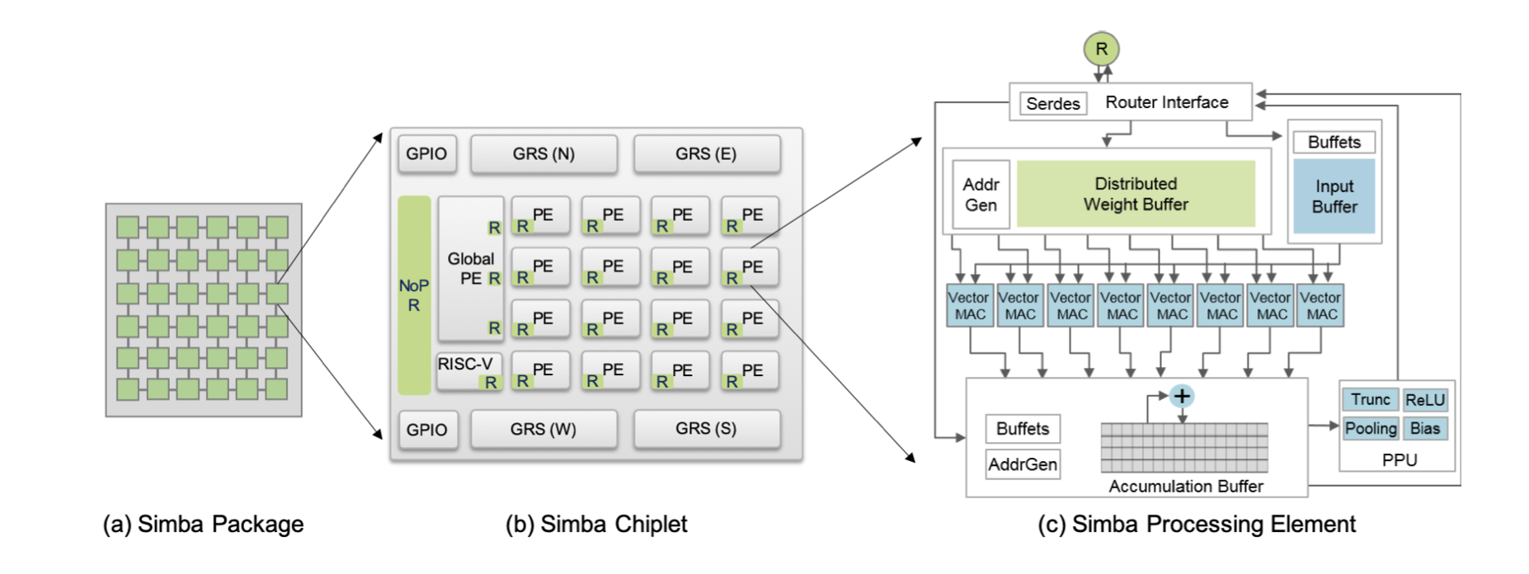
SIMBA: Baseline Architecture
First Chiplet-based Deep Learning System
Shao, Yakun Sophia, et al. "Simba: Scaling deep-learning inference with multi-chip-module-based architecture." Proceedings of the 52nd annual IEEE/ACM international symposium on microarchitecture. 2019.

Slide 12
( TSMC 16nm FinFET )
https://hackmd.io/@nctu-cas-lab/rJTovb6td

Slide 13
Paper Outline
INDM: Chiplet-Based Interconnect Network and Dataflow Mapping for DNN Accelerators (IEEE TCAD 2024)
Gemini: Mapping and Architecture Co-exploration for Large-scale DNN Chiplet Accelerators (HPCA2024)
Florets for Chiplets: Data Flow-aware High-Performance and Energy-efficient Network-on-Interposer for CNN Inference Tasks (ACM TECS 2023)
TEFLON: Thermally Efficient Dataflow-aware 3D NoC for Accelerating CNN Inferencing on Manycore PIM Architectures (ACM TECS 2024)

Slide 14
INDM: Chiplet-Based Interconnect Network and Dataflow Mapping for DNN Accelerators (IEEE TCAD 2024)
An efficient hierarchical interconnect network composed of a multiring on-die network and a cluster-based inter-die network is proposed to facilitate the data reuse and traffic pattern in DNN workloads.
An exploration framework of architectural partitioning and topology evaluation is proposed to find the optimal architecture configuration with the best tradeoff among performance, energy and chip area.

Slide 15
Motivation
Overhead of inter-die communication has become performance bottleneck.
Architecture partitioning: partition one monolithic chip into multiple smaller chiplets, opens up huge design space.
Traditional dataflow mapping for monolithic chips are inefficient for chiplet-based architectures.

Slide 16
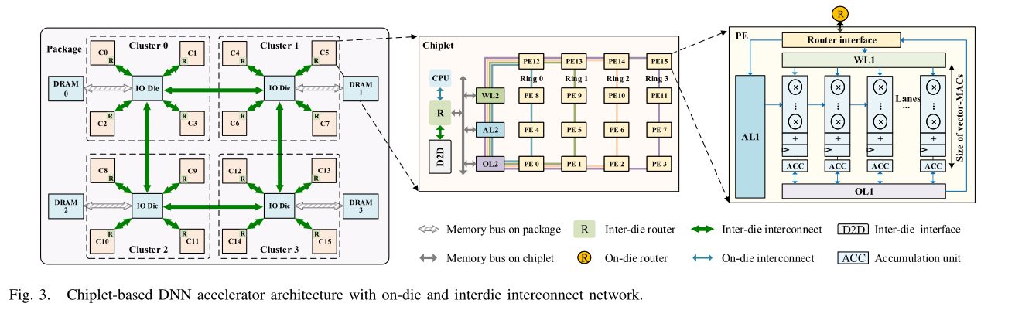
Architecture
Jinming Zhang, Xi Fan, Yaoyao Ye, Xuyan Wang, Guojie Xiong, Xianglun Leng, Ningyi Xu, Yong Lian, and Guanghui He. 2024. INDM: Chiplet-Based Interconnect Network and Dataflow Mapping for DNN Accelerators. Trans. Comp.-Aided Des. Integ. Cir. Sys. 43, 4 (April 2024), 1107–1120. https://doi.org/10.1109/TCAD.2023.3332832

Slide 17
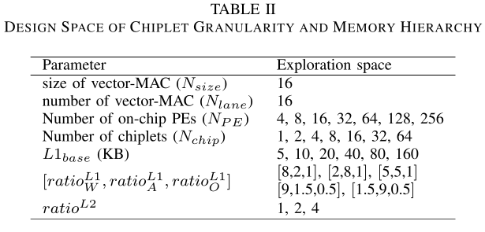
Exploration of Architecture Partitioning
Architectural partitioning: partition one monolithic chip into multiple smaller chiplets to reduce the manufacture costs.
Latency estimation model
Metric: EDP (energy-delay-product) with area constraint
Jinming Zhang, Xi Fan, Yaoyao Ye, Xuyan Wang, Guojie Xiong, Xianglun Leng, Ningyi Xu, Yong Lian, and Guanghui He. 2024. INDM: Chiplet-Based Interconnect Network and Dataflow Mapping for DNN Accelerators. Trans. Comp.-Aided Des. Integ. Cir. Sys. 43, 4 (April 2024), 1107–1120. https://doi.org/10.1109/TCAD.2023.3332832

Slide 18
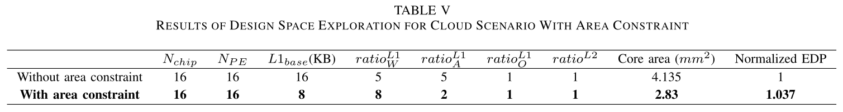
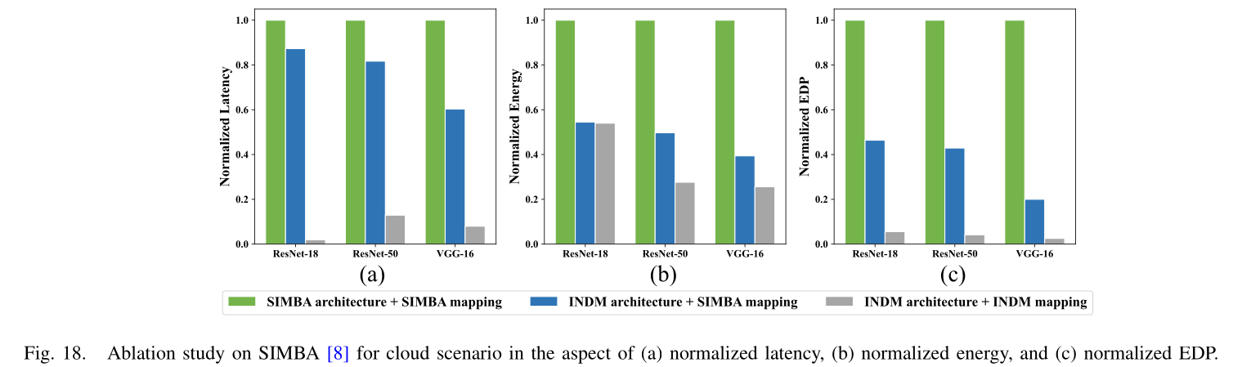
Experiments
Jinming Zhang, Xi Fan, Yaoyao Ye, Xuyan Wang, Guojie Xiong, Xianglun Leng, Ningyi Xu, Yong Lian, and Guanghui He. 2024. INDM: Chiplet-Based Interconnect Network and Dataflow Mapping for DNN Accelerators. Trans. Comp.-Aided Des. Integ. Cir. Sys. 43, 4 (April 2024), 1107–1120. https://doi.org/10.1109/TCAD.2023.3332832

Slide 19
Gemini: Mapping and Architecture Co-exploration for Large-scale DNN Chiplet Accelerators (HPCA2024)
Proposed a layer-centric encoding method to encode Layer-Pipeline (LP) spatial mapping for large-scale DNN inference accelerators and depict the optimization space of it.
Propose an architecture and mapping co-exploration framework, Gemini, to explore the design and mapping space of large-scale DNN chiplet accelerators while taking monetary cost (MC), performance, and energy efficiency into account.

Slide 20
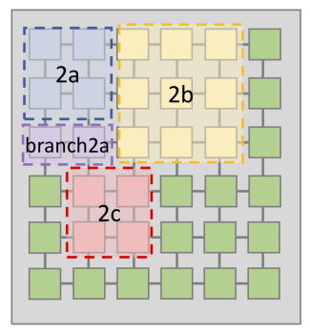
Motivation
Optimal chiplet granularity: Trade-off between using more smaller chiplets for better yield and fewer larger chiplets for lower chiplet costs.
DNN mapping
Maintain high utilization and energy efficiency
Layer-Pipeline (LP) mapping in which multiple layers are spatially mapped onto the accelerator.
Shao, Yakun Sophia, et al. "Simba: Scaling deep-learning inference with multi-chip-module-based architecture." Proceedings of the 52nd annual IEEE/ACM international symposium on microarchitecture. 2019.

Slide 21
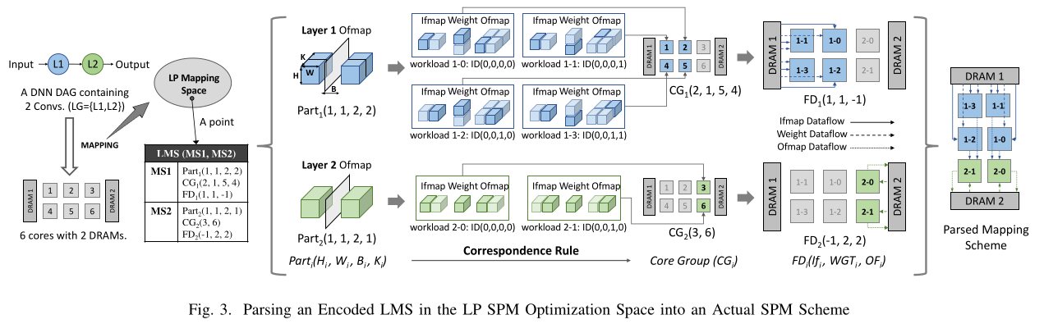
Layer Pipeline Spatial Mapping Encoding
LP – layer pipeline, CG - core graph, MS - mapping scheme, FD – flow of data, LG-layer group
Cai, Jingwei, et al. "Gemini: Mapping and architecture co-exploration for large-scale dnn chiplet accelerators." 2024 IEEE International Symposium on High-Performance Computer Architecture (HPCA). IEEE, 2024.

Slide 22
Experiments
We compare Gemini’s explored design (G-Arch, G-Map) against baselines: Simba-based (S-Arch, T-Map) and Tenstorrent-based (T-Arch, T-Map).
G-Arch vs. S-Arch: G-Arch with G-Map reduces delay by 46.8% and energy by 28.8% over S-Arch with T-Map, with only 14.3% more MC (Monetary Cost). Achieved by reducing chiplet count, increasing interconnect bandwidth, and doubling buffer capacity-minimizing D2D overhead.
G-Arch vs. T-Arch: Compared to T-Arch with T-Map, Gemini improves performance by 1.74×, energy efficiency by 1.13×, and reduces MC by 40.1%

Slide 23
Florets for Chiplets: Data Flow-aware High-Performance and Energy-efficient Network-on-Interposer for CNN Inference Tasks (ACM TECS 2023)
It proposes novel NoI architecture Floret on 2.5D chiplet-based PIM enabled systems with multiple non-overlapping SFCs targeting multiple concurrent CNN inference task
a new type of SFC called the Floret curve, is targeted for chiplet-based systems, to efficiently map successive neural layers to contiguous chiplets for achieving high performance and energy efficiency

Slide 24
Motivation
Challenge of Chiplet Based system: Communication
System Scalability and fabrication cost hinder widespread adoption.
Poor technology scaling of the wires
Large physical distance between chiplets
Power-constrained environment
Energy consumption is the bottleneck for NoI
Therefore, An efficient NoI can solve this problem
Note: NoI consumes 80% of the total area of the 2.5D based system

Slide 25
Motivation
Dataflow graph of CNN is mostly linear, so consecutive neural layers needs to be mapped to neighbouring chiplets to reduce latency
Traditional Network-on-Interposer (NoI) architectures does not guarantee successive neural layers mapped to contiguously placed chiplets
Issues in Conventional/Existing NoI designs such as mesh, torus, kite:
leads to long-range communication
Higher energy consumption (router + link energy)
Congestion bottleneck
Lack of awareness of the actual dataflow pattern of CNN
Poor Scalability for concurrent Inference workloads
assumes a fixed and single application workload
Floret : Concurrent CNN tasks at Datacenter-scale

Slide 26
Approach
Proposes a first workload aware NoI architecture for Datacenter-scale DL workload, Floret on 2.5D ReRAM based PIM chiplets with multiple non-overlapping SFCs targeting multiple concurrent CNN inference task
It performs/achieves :
Efficient Task Mapping (h/w and s/w co-design)
Exploits Dataflow Pattern of CNN
Optimizes the Inter-Chiplet data exchange
Performs CNN Inference concurrently

Slide 27
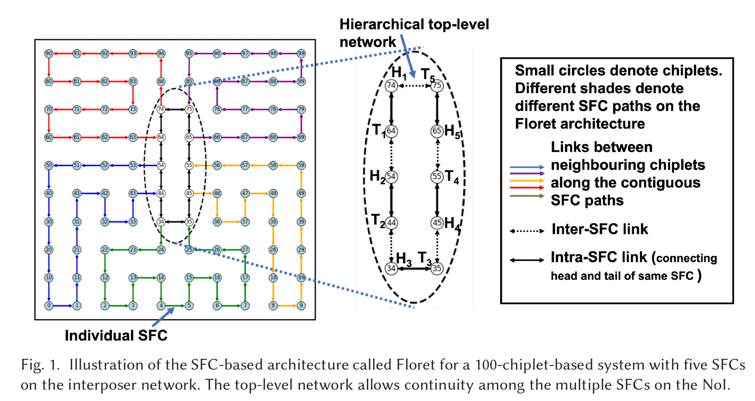
Space Filling Curve enabled NoI Architecture
Floret Curve = multiple disjoint SFCs (like petals of a flower)
Space Filling Curve enabled NoI Architecture
Space-filling curve
Space-filling curve (SFCs) represent a special class of algorithm mapping techniques
Widely used to generate data locality-preserving data structures in scientific application
SFC traverses the area of the interposer with no closed loops
Floret Curve = multiple disjoint SFCs (like petals of a flower)
Harsh Sharma, Lukas Pfromm, Rasit Onur Topaloglu, Janardhan Rao Doppa, Umit Y. Ogras, Ananth Kalyanraman, and Partha Pratim Pande. 2023. Florets for Chiplets: Data Flow-aware High-Performance and Energy-efficient Network-on-Interposer for CNN Inference Tasks. A
CM Trans. Embed. Comput. Syst. 22, 5s, Article 132 (October 2023), 21 pages. https://doi.org/10.1145/3608098

Slide 28
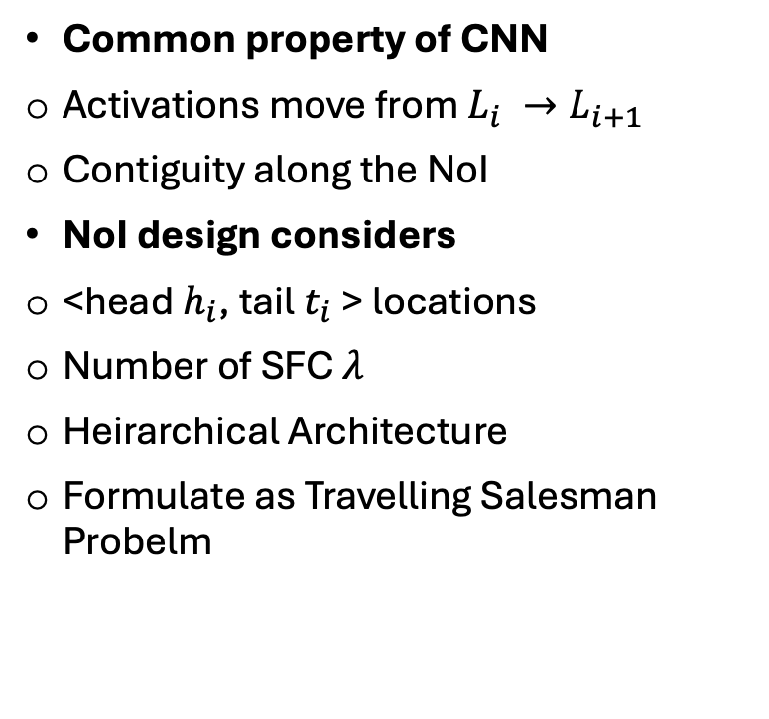
Space Filling Curve enabled NoI Architecture
Common property of CNN
Activations move from $L_{i} →L_{i+1}$
Contiguity along the NoI
NoI design considers
<head $h_{i}$, tail $t_{i}$> locations
Number of SFC $λ$
Heirarchical Architecture
Formulate as Travelling Salesman Probelm
Harsh Sharma, Lukas Pfromm, Rasit Onur Topaloglu, Janardhan Rao Doppa, Umit Y. Ogras, Ananth Kalyanraman, and Partha Pratim Pande. 2023. Florets for Chiplets: Data Flow-aware High-Performance and Energy-efficient Network-on-Interposer for CNN Inference Tasks. A
CM Trans. Embed. Comput. Syst. 22, 5s, Article 132 (October 2023), 21 pages. https://doi.org/10.1145/3608098

Slide 29
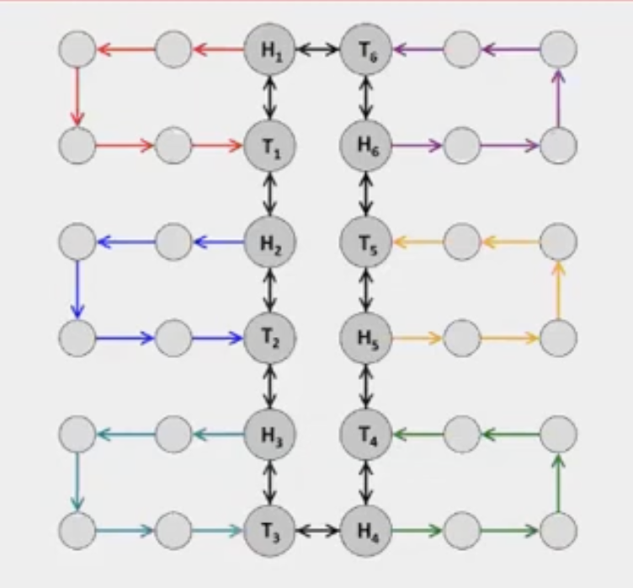
Mapping Algorithm
In Floret, we map neural network to the sequence of chiplets in a Hamiltonian path (along the SFC NoI)
Chiplet resources become available for new layer allocation in the order are mapped (beneficial in large workloads)
During mapping, we reach the tail of one SFC, we have more than one option for selecting the next SFC
Mapping exploits inherent Redundancy of Floret Architecture
https://www.youtube.com/watch?v=4wa_UK5WCmg&t=617s

Slide 30
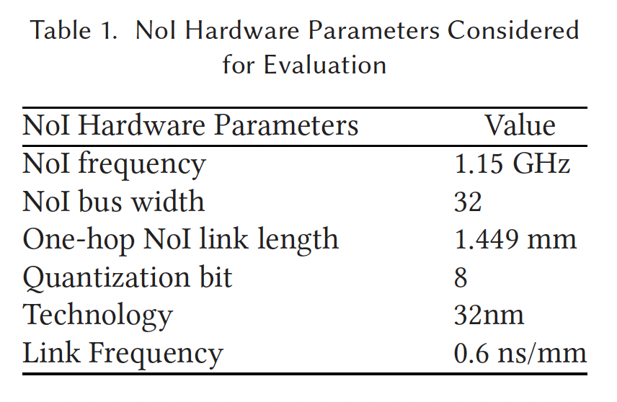
Experimental Setup
Uses a modified NeuroSim to partition and map CNN tasks onto a 2.5D-based system
All the NoI topologies are simulated using the BookSim simulator
Inputs to the BookSim simulator are the connectivity between NoI routers and the inter-chiplet traffic for the concurrent CNN inference tasks. It outputs the area, latency, and energy consumption of the NoI
Uses the Nvidia’s ground-referenced signalling (GRS) parameters for chiplets on a 32nm technology to evaluate the NoI area and power consumption
the scalability of the Floret architecture, we consider four different system sizes (n) with 36, 64, 81, and 100 chiplets.
Harsh Sharma, Lukas Pfromm, Rasit Onur Topaloglu, Janardhan Rao Doppa, Umit Y. Ogras, Ananth Kalyanraman, and Partha Pratim Pande. 2023. Florets for Chiplets: Data Flow-aware High-Performance and Energy-efficient Network-on-Interposer for CNN Inference Tasks. A
CM Trans. Embed. Comput. Syst. 22, 5s, Article 132 (October 2023), 21 pages. https://doi.org/10.1145/3608098

Slide 31
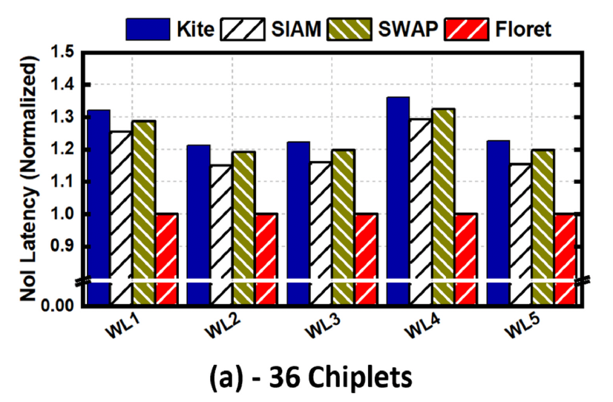
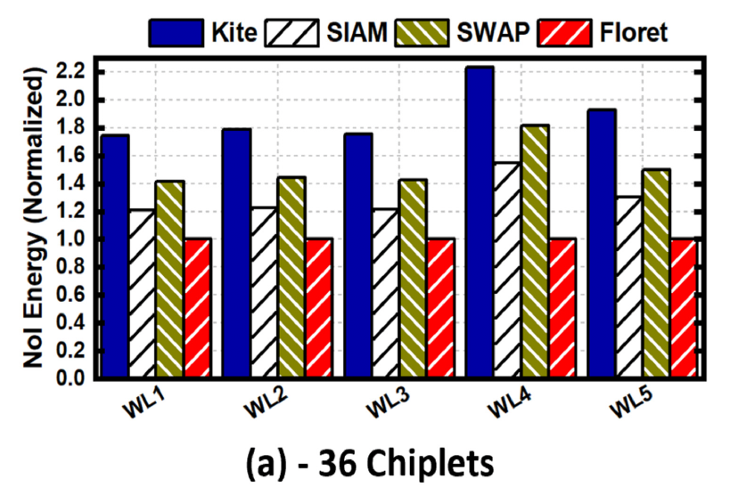
Experimental results show that the Floret architecture can achieve up to 58% and 64% reduction in latency and energy respectively compared to state-of-the-art counterparts.
Harsh Sharma, Lukas Pfromm, Rasit Onur Topaloglu, Janardhan Rao Doppa, Umit Y. Ogras, Ananth Kalyanraman, and Partha Pratim Pande. 2023. Florets for Chiplets: Data Flow-aware High-Performance and Energy-efficient Network-on-Interposer for CNN Inference Tasks. A
CM Trans. Embed. Comput. Syst. 22, 5s, Article 132 (October 2023), 21 pages. https://doi.org/10.1145/3608098

Slide 32
TEFLON: Thermally Efficient Dataflow-aware 3D NoC for Accelerating CNN Inferencing on Manycore PIM Architectures (ACM TECS 2024)
It proposes TEFLON, a methodology to design thermally efficient dataflow-aware M3D NoC for accelerating CNN inferencing
Proposed methodology constructs 3D space-filling curves (SFCs) that are specifically tailored for optimal performance in inference tasks with deep CNN workloads without creating thermal bottlenecks
For Accelerating CNN Inferencing on Manycore PIM Architectures

Slide 33
Motivation
CNNs on manycore ReRAM-based PIM systems suffer from:
Inefficient data movement
Thermal hotspots → accuracy loss in ReRAM
Existing SFC-based NoCs designs (e.g., Floret) optimize performance but neglect thermal-awareness
Need for thermally-aware mapping in 3D NoC while preserving performance and accuracy
Goal: Design a NoC that balances latency, energy, and thermal profile for CNN inference.

Slide 34
Approach
3D Monolithic NoC design using M3D integration
Key components:
Space-Filling Curves (SFC) for dataflow-aware mapping
Thermal-aware layer placement to avoid vertical stacking of hot Pes
AMOSA-based MOO multi-objective optimization: { Latency, Inference accuracy, Temperature }

Slide 35
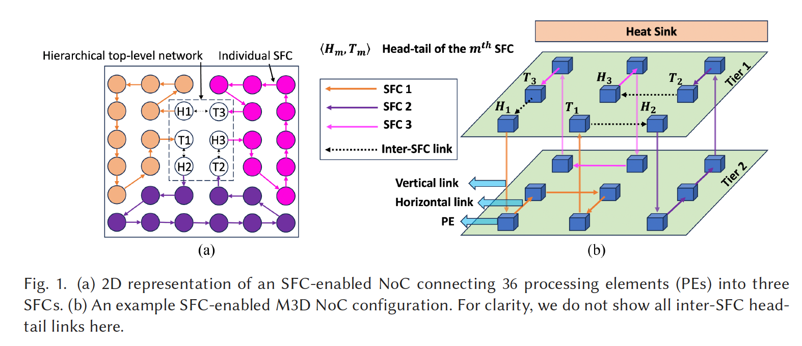
Architecture
Monolithic 3D NoC architecture using ReRAM-based PEs.
Communication Link Strategy
Vertical links (between tiers):
Fast due to short interconnects.
But increase heat – can damage ReRAM and hurt accuracy.
Horizontal links (within tiers):
Cooler due to easier heat dissipation.
Slightly slower but better for thermal balance.
TEFLON strategically uses both to optimize performance and thermal reliability.
Gaurav Narang, Chukwufumnanya Ogbogu, Janardhan Rao Doppa, and Partha Pratim Pande. 2024. TEFLON: Thermally Efficient Dataflow-aware 3D NoC for Accelerating CNN Inferencing on Manycore PIM Architectures. ACM Trans. Embed. Comput. Syst. 23, 5, Article 78 (September 2024), 23 pages. https://doi.org/10.1145/3665279

Slide 36
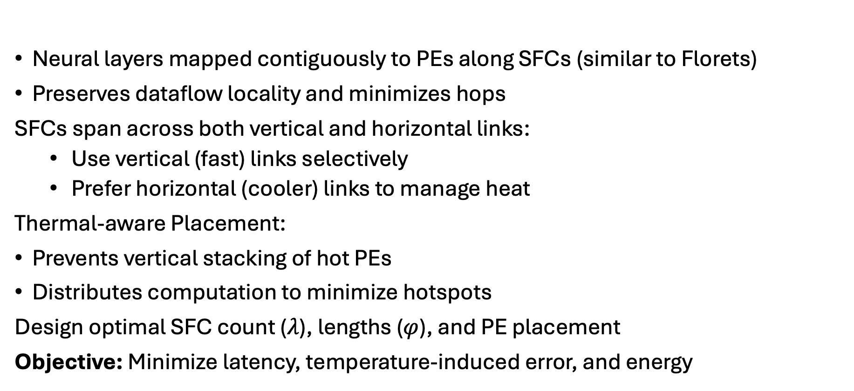
Mapping
Neural layers mapped contiguously to PEs along SFCs (similar to Florets)
Preserves dataflow locality and minimizes hops
SFCs span across both vertical and horizontal links:
Use vertical (fast) links selectively
Prefer horizontal (cooler) links to manage heat
Thermal-aware Placement:
Prevents vertical stacking of hot PEs
Distributes computation to minimize hotspots
Design optimal SFC count ($λ$), lengths ($φ$), and PE placement
Objective: Minimize latency, temperature-induced error, and energy

Slide 37
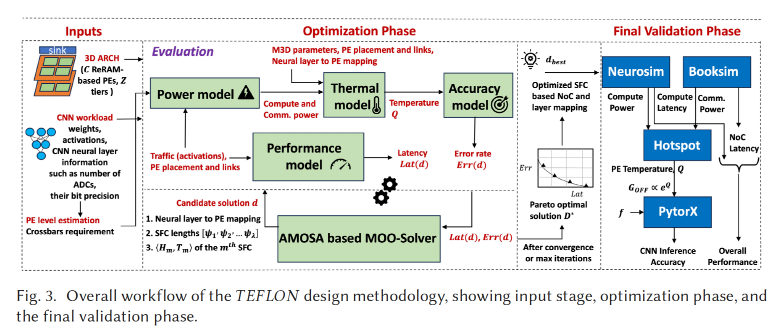
Gaurav Narang, Chukwufumnanya Ogbogu, Janardhan Rao Doppa, and Partha Pratim Pande. 2024. TEFLON: Thermally Efficient Dataflow-aware 3D NoC for Accelerating CNN Inferencing on Manycore PIM Architectures. ACM Trans. Embed. Comput. Syst. 23, 5, Article 78 (September 2024), 23 pages. https://doi.org/10.1145/3665279

Slide 38
Experimental Setup
Workloads: CIFAR-10, CIFAR-100 CNN models
Baselines: Mesh-Naive, Mesh-Opt, Floret
Evaluation metrics:
Latency
EDP
Peak temperature
Inference accuracy

Slide 39
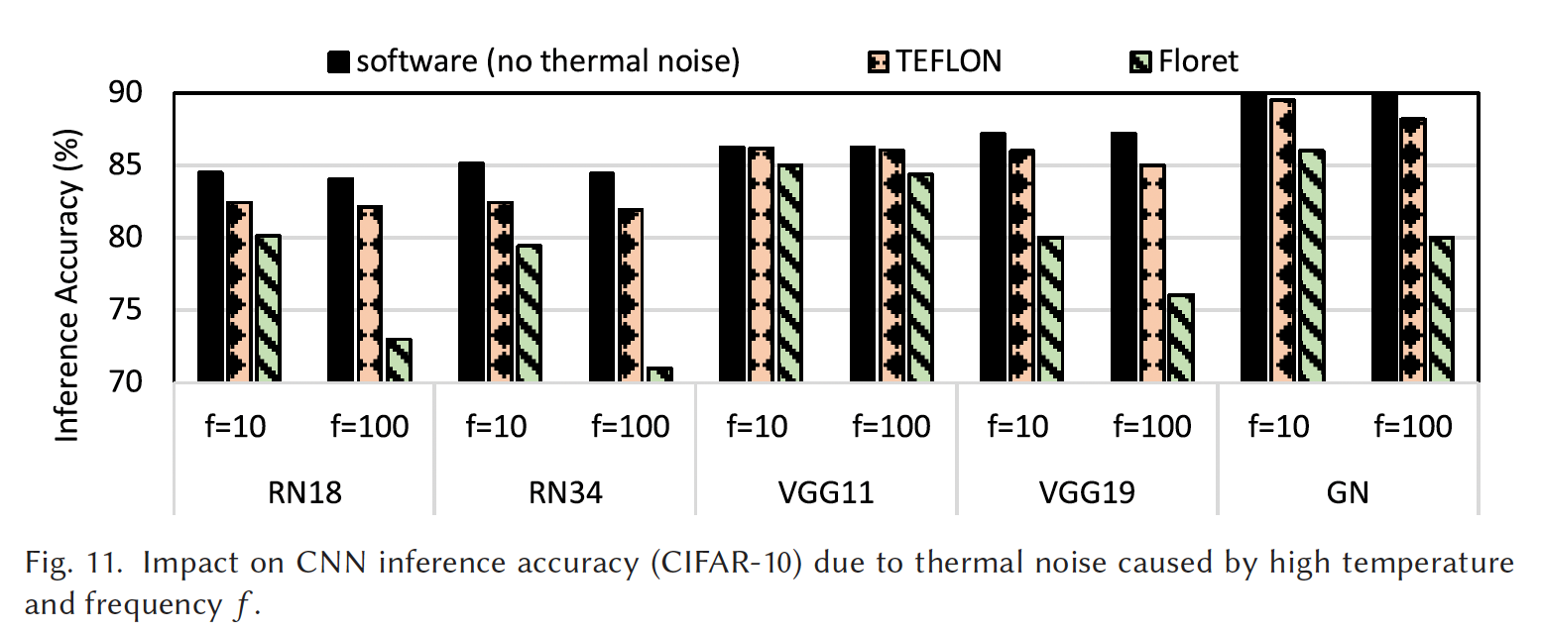
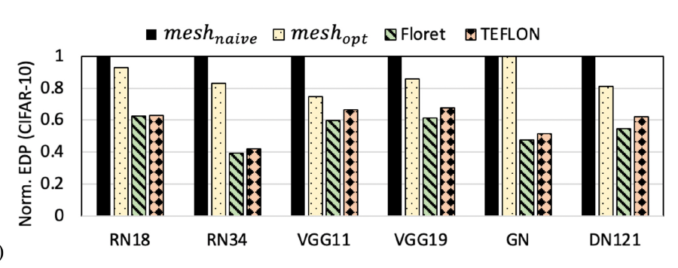
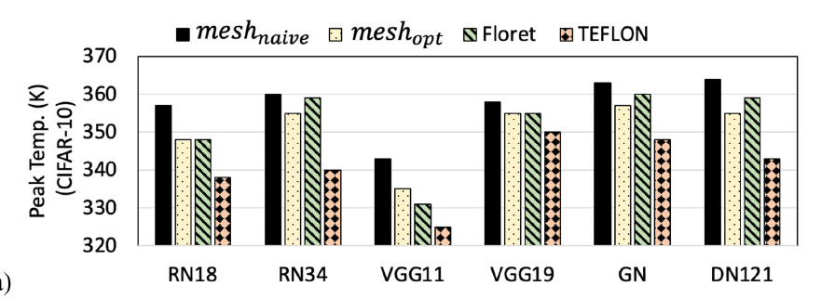
EDP reduced by up to 46%
Temperature reduced by 25K
Inference accuracy improved by up to 11%
Scales across 36-, 64-, and 100-PE systems
Gaurav Narang, Chukwufumnanya Ogbogu, Janardhan Rao Doppa, and Partha Pratim Pande. 2024. TEFLON: Thermally Efficient Dataflow-aware 3D NoC for Accelerating CNN Inferencing on Manycore PIM Architectures. ACM Trans. Embed. Comput. Syst. 23, 5, Article 78 (September 2024), 23 pages. https://doi.org/10.1145/3665279

Slide 40
Conclusion
As Deep Learning models continue to scale in size and complexity, traditional monolithic accelerators face growing limitations in performance, energy efficiency, and manufacturability.
Chiplet-based architectures combined with in-memory computing are promising alternative, offering modularity, scalability, and reduced communication overheads.
INDM’s hierarchical interconnects and interdie-aware dataflow mapping
Gemini’s architecture-mapping co-exploration
Floret’s communication-aware NoI design
TEFLON’s thermally optimized 3D layout
We have highlighted how thoughtful hardware-software co-design can mitigate challenges such as dataflow mapping, workload partitioning, inter-chiplet communication, and thermal constraints.

Slide 41
Thank You All For listening

